Slide 1


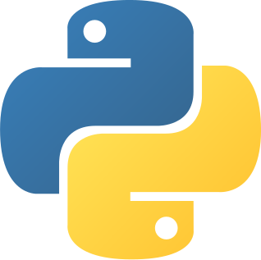

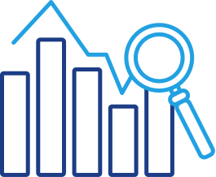
WINE DATASET IN PYTHON
Guided by:-Shubhangi Kale(MITAOE)
Presented by:-
202:Suryansh Ambekar(202201090042)
211:Atharva Bramhankar(202201060051)
215:Shrushty Dhamange(202201070016)

Slide 2

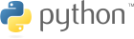
Introduction
Data analytics is the process of examining vast volumes of data to
extract meaningful patterns, trends, and correlations.
In the context of the Wine Quality dataset, data analysis becomes a
window through which we can do various analysis such as data
manipulation, data visualization ,etc.
By this process we will understand how many types of wine are there, quantity of acids in the wine, the measured pH of each wine, the quality and reviews regarding the same,etc within the dataset.

Slide 3
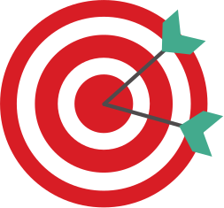
Motivation
There are many wine lovers in the world and this dataset allows us to review how much quantities of each ingredient is added in wine and how it affects the quality and reviews of wine. This dataset allows us a chance to get an insight of the wine making process.
This dataset gives us a chance to make predictive anaylisis about what many people prefer.

Slide 4

Details of Dataset
Name of Dataset:-Wine Quality dataset
Number of Features:-14
Number of Records:-6497

Slide 5
Data Manipulation
Data manipulation refers to the process of modifying, transforming, or reorganizing data to extract meaningful insights or prepare it for further analysis. It involves various operations performed on the data, such as filtering, sorting, aggregating, merging, and reshaping, among others.
Data manipulation is an essential step in the data analysis workflow as it helps to clean, preprocess, and transform raw data into a format that is suitable for analysis or visualization. It allows data scientists and analysts to extract valuable information, discover patterns, and derive meaningful insights from the data.

Slide 6
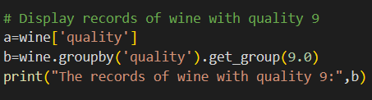
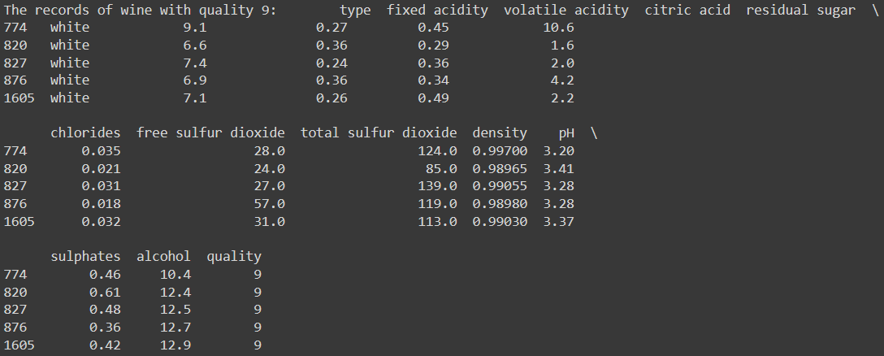

Slide 7
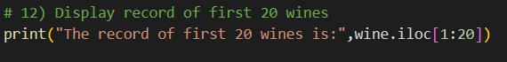
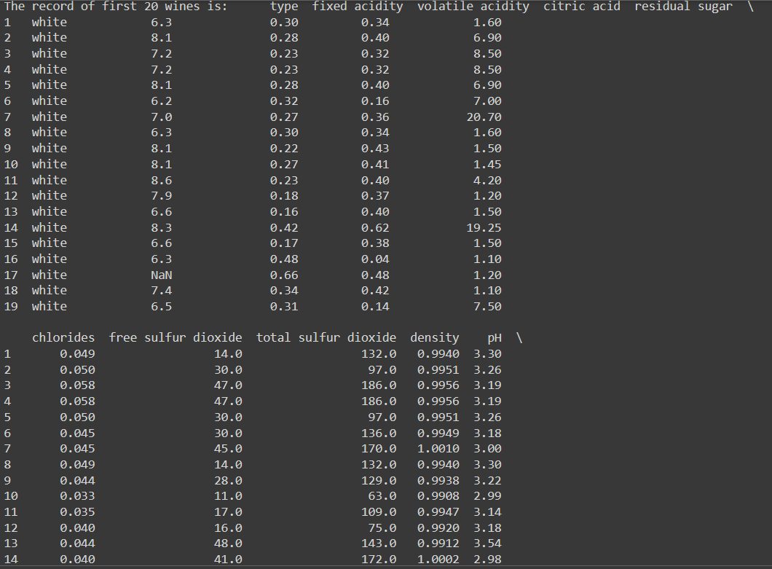

Slide 8
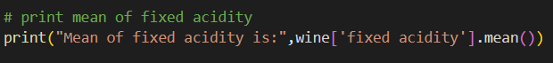

Slide 9
Data Visualization
Data visualization refers to the graphical representation of data using visual elements such as charts, graphs, and plots. It is a powerful tool for exploring, analyzing, and communicating data patterns, trends, and insights.
In Python, there are several libraries available for data visualization, with Matplotlib being one of the most popular and widely used. Matplotlib provides a flexible and comprehensive set of functions and methods for creating various types of visualizations.

Slide 10
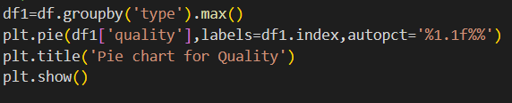
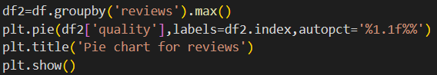
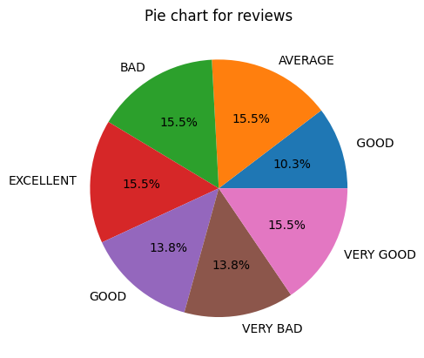
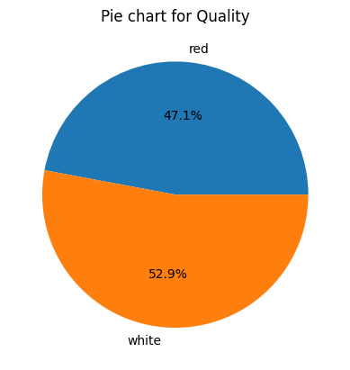

Slide 11
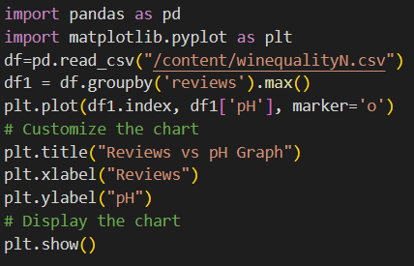
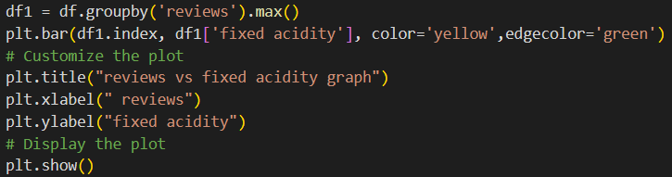
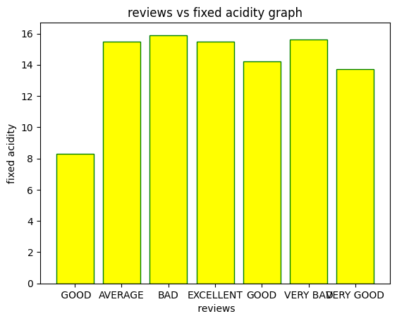
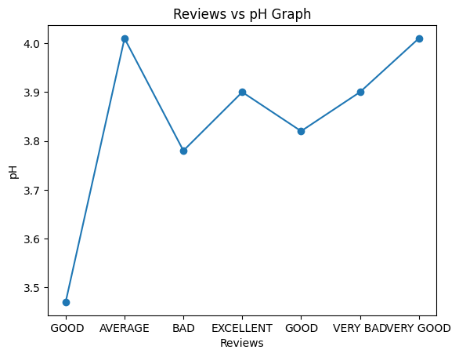

Slide 12
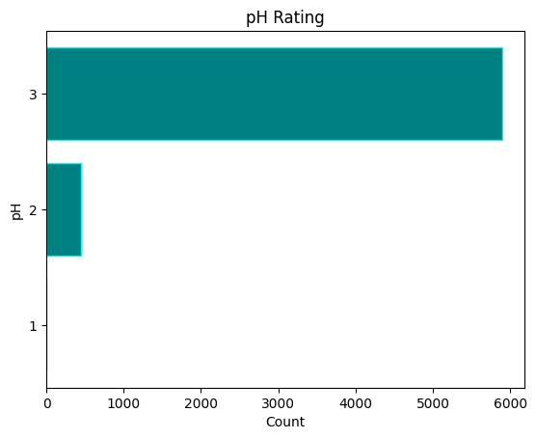
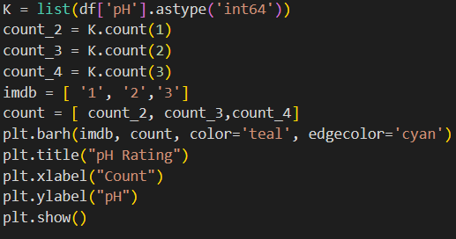

Slide 13
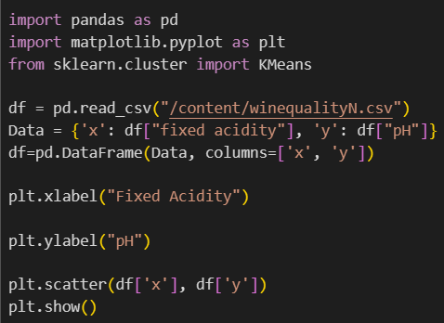
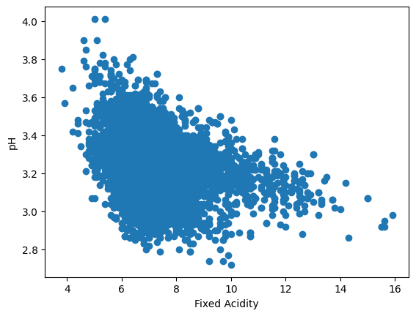
Predictive Technique (KMeans)
K-means clustering is a popular algorithm used to partition a dataset into distinct groups or clusters based on their similarities. The goal is to find clusters that minimize the within-cluster sum of squares.

Slide 14
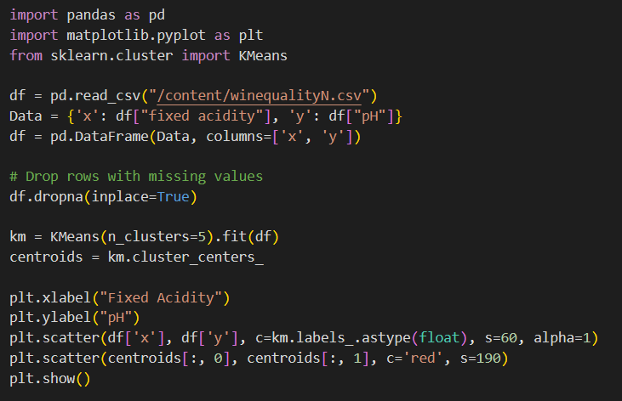
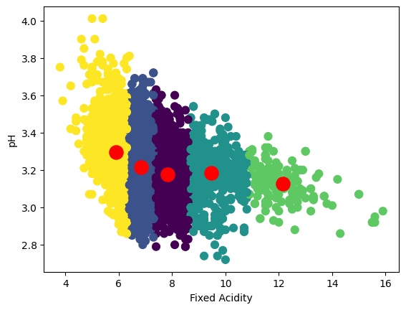

Slide 15
Application
By cleaning, filtering, and transforming the dataset, you can gain a deeper understanding of the data
Contemplating the Wine Quality dataset we got to uncover patterns and relations between variables.
Plots such as histograms, scatter plots and bar charts can provide visual representations.
After performing data manipulation and contemplating the data the clusters formed using KMeans, the resulting clusters can serve as new features for predictive modeling.
These cluster labels can be used as input features to build a classification model to predict several other factors which affect quality of wine

Slide 16
Conclusion
In Summary, this analysis of the dataset has provided valuable insights regarding the making of wine and it ingredients.
We discovered significant correlations between quality and variables such as pH, fixed acidity, total sulfur dioxide, and reviews.
Through data cleaning, preprocessing, visualization, and modeling, we were able to extract meaningful information.

Slide 17
﻿THANK YOU

